Slide 1
English Stylistics
Week 13 Quiz

Slide 2
Quiz
Individual work
No dictionaries, reference books, handouts, etc.
No phones and other electronic devices.
English language
60 minutes

Slide 3
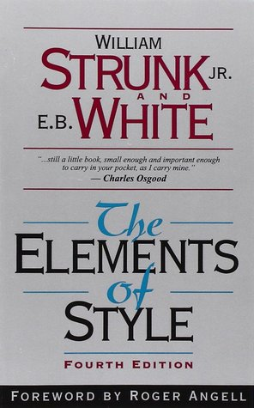
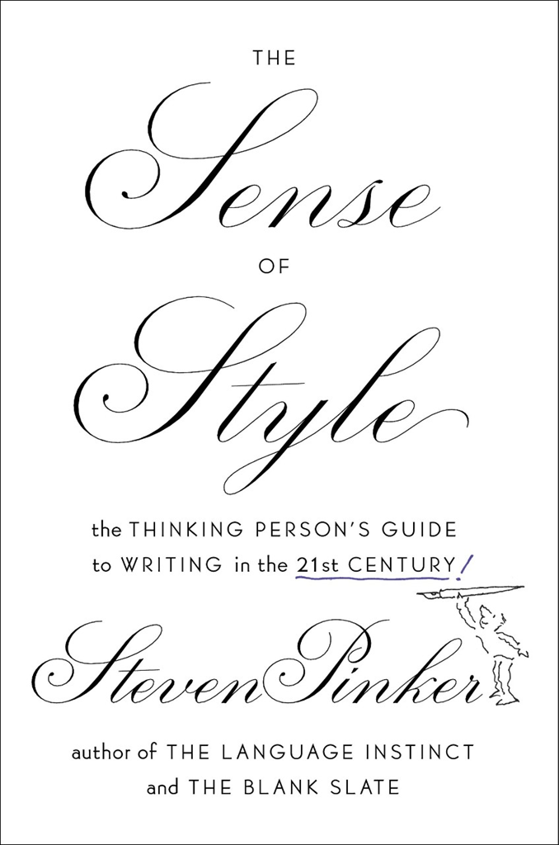


Slide 4
The Sense of Style (2014)
Chapter 1 Good writing
Chapter 2 A window onto the world
Chapter 3 The curse of knowledge
Chapter 4 The web, the tree and the string
Chapter 5 Arcs of coherence
Chapter 6 Telling right from wrong

Slide 5
General requirements
1. A stylistic review of one chapter
2. Title, summary, interpretation and evaluation
3. Focus on STYLE
3. 1200-1500 words

Slide 6
Content requirements
Summary – What is the main argument?
Interpretation – How did Pinker elaborate on his argument? What kind of examples and techniques did he use to argue effectively?
Evaluation – what is your opinion of his argument? What are the merits and drawbacks in his argumentation? What about his own style?

Slide 7
Course plan (Week 13-16)
Week 13 Semantic features
Week 14 Academic writing style + In-class paragraph writing
Week 15 Paragraph writing review + other stylistic features
Week 16 Course summary and reflection
Final Paper Deadline: Jan 21st, 2021 (Thursday)

